Slide 1
Foundations of Cryptography Merkle-Damgård Transform, Hash-and-MAC
LiangFeng Zhang
zhanglf@shanghaitech.edu.cn
SIST, ShanghaiTech, 2019F

Slide 2


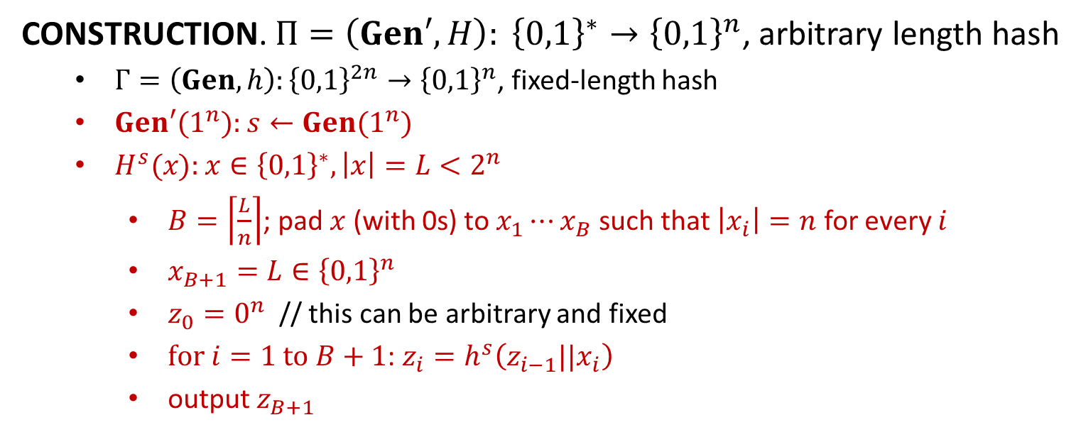












Merkle-Damgård Transform
$$x_{1}$$
$$x_{2}$$
$$⋯$$
$$x_{B}$$
$$x_{B+1}=L$$
$$z_{0}$$
$$h^{s}$$
$$h^{s}$$
$$⋯$$
$$h^{s}$$
$$h^{s}$$
$$H^{s}\left(x\right)=z_{B+1}$$
$$z_{1}$$
$$z_{2}$$
$$z_{B}$$
CONSTRUCTION. $Π=\left(Gen′, H\right): {\left\{0,1\right\}}^{∗}→{\left\{0,1\right\}}^{n}$, arbitrary length hash
$Γ=\left(Gen,h\right):{\left\{0,1\right\}}^{2n}→{\left\{0,1\right\}}^{n}$, fixed-length hash
$Gen′(1^{n}):$ $s←Gen(1^{n})$
$H^{s}(x):$ $x∈{\left\{0,1\right\}}^{∗}, \left|x\right|=L<2^{n}$
$B=\left\lceil \frac{L}{n}\right\rceil$; pad $x$ (with 0s) to $x_{1}⋯x_{B}$ such that $\left|x_{i}\right|=n$ for every $i$
$x_{B+1}=L∈{\left\{0,1\right\}}^{n}$
$z_{0}=0^{n}$ // this can be arbitrary and fixed
$for i=1 to B+1$: $z_{i}=h^{s}\left(z_{i−1}||x_{i}\right)$
output $z_{B+1}$
Examples: MD5; SHA family

Slide 3

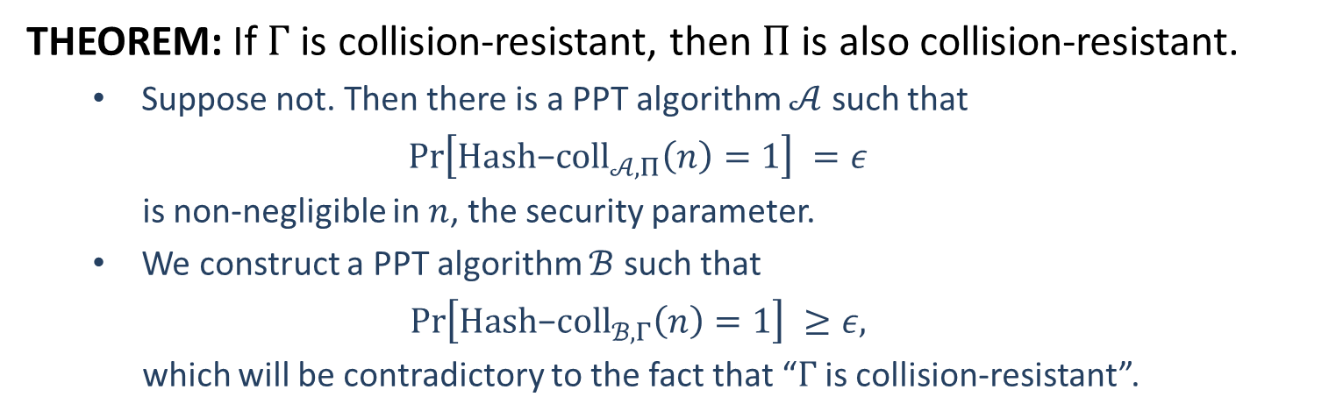






Merkle-Damgård Transform
THEOREM: If $Γ$ is collision-resistant, then $Π$ is also collision-resistant.
Suppose not. Then there is a PPT algorithm $𝒜$ such that
$$\operatorname{Pr}\left[Hash\text{−}coll_{𝒜,Π}\left(n\right)=1\right] =ε$$
is non-negligible in $n$, the security parameter.
We construct a PPT algorithm $ℬ$ such that
$$\operatorname{Pr}\left[Hash\text{−}coll_{ℬ,Γ}\left(n\right)=1\right] ≥ε,$$
which will be contradictory to the fact that “$Γ$ is collision-resistant”.
$$s←Gen\left(1^{n}\right)$$
$$s$$
$$s$$
?
$$(x,x^{′})$$
$$(y,y^{′})$$
challenger
$$ℬ$$
$$𝒜$$

Slide 4




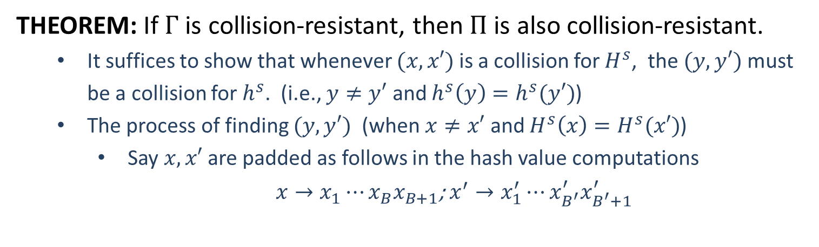
























Merkle-Damgård Transform
THEOREM: If $Γ$ is collision-resistant, then $Π$ is also collision-resistant.
It suffices to show that whenever $(x,x′)$ is a collision for $H^{s}$, the $(y,y′)$ must be a collision for $h^{s}$. (i.e., $y≠y′$ and $h^{s}\left(y\right)=h^{s}(y′)$)
The process of finding $(y,y′)$ (when $x≠x′$ and $H^{s}\left(x\right)=H^{s}(x′)$)
Say $x,x′$ are padded as follows in the hash value computations
$x→x_{1}⋯x_{B}x_{B+1}$; $x^{′}→x_{1}^{′}⋯x_{B^{′}}^{′}x_{B^{′}+1}^{′}$
$$x_{1}$$
$$x_{2}$$
$$⋯$$
$$x_{B}$$
$$x_{B+1}$$
$$z_{0}$$
$$h^{s}$$
$$h^{s}$$
$$⋯$$
$$h^{s}$$
$$h^{s}$$
$$H^{s}\left(x\right)$$
$$z_{1}$$
$$z_{2}$$
$$z_{B}$$
$$x_{1}^{′}$$
$$x_{2}^{′}$$
$$⋯$$
$$x_{B^{′}}^{′}$$
$$x_{B^{′}+1}^{′}$$
$$z_{0}^{′}$$
$$h^{s}$$
$$h^{s}$$
$$⋯$$
$$h^{s}$$
$$h^{s}$$
$$H^{s}\left(x′\right)$$
$$z_{1}^{′}$$
$$z_{2}^{′}$$
$$z_{B^{′}}^{′}$$

Slide 5
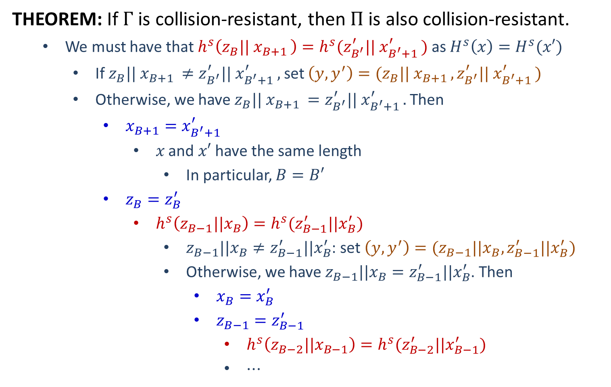
Merkle-Damgård Transform
THEOREM: If $Γ$ is collision-resistant, then $Π$ is also collision-resistant.
We must have that $h^{s}\left(z_{B}|| x_{B+1 }\right)=h^{s}(z_{B^{′}}^{′}|| x_{B^{′}+1 }^{′})$ as $H^{s}\left(x\right)=H^{s}(x′)$
If $z_{B}|| x_{B+1 }≠z_{B^{′}}^{′}|| x_{B^{′}+1 }^{′},$ set $\left(y,y^{′}\right)=(z_{B}|| x_{B+1 },z_{B^{′}}^{′}|| x_{B^{′}+1 }^{′})$
Otherwise, we have $z_{B}|| x_{B+1 }=z_{B^{′}}^{′}|| x_{B^{′}+1 }^{′}.$ Then
$x_{B+1}=x_{B^{′}+1}^{′}$
$x$ and $x′$ have the same length
In particular, $B=B′$
$z_{B}=z_{B}^{′}$
$h^{s}\left(z_{B−1}||x_{B}\right)=h^{s}(z_{B−1}^{′}||x_{B}^{′})$
$z_{B−1}||x_{B}≠z_{B−1}^{′}||x_{B}^{′}$: set $\left(y,y^{′}\right)=(z_{B−1}||x_{B},z_{B−1}^{′}||x_{B}^{′})$
Otherwise, we have $z_{B−1}||x_{B}=z_{B−1}^{′}||x_{B}^{′}$. Then
$x_{B}=x_{B}^{′}$
$z_{B−1}=z_{B−1}^{′}$
$h^{s}\left(z_{B−2}||x_{B−1}\right)=h^{s}(z_{B−2}^{′}||x_{B−1}^{′})$
$⋯$

Slide 6
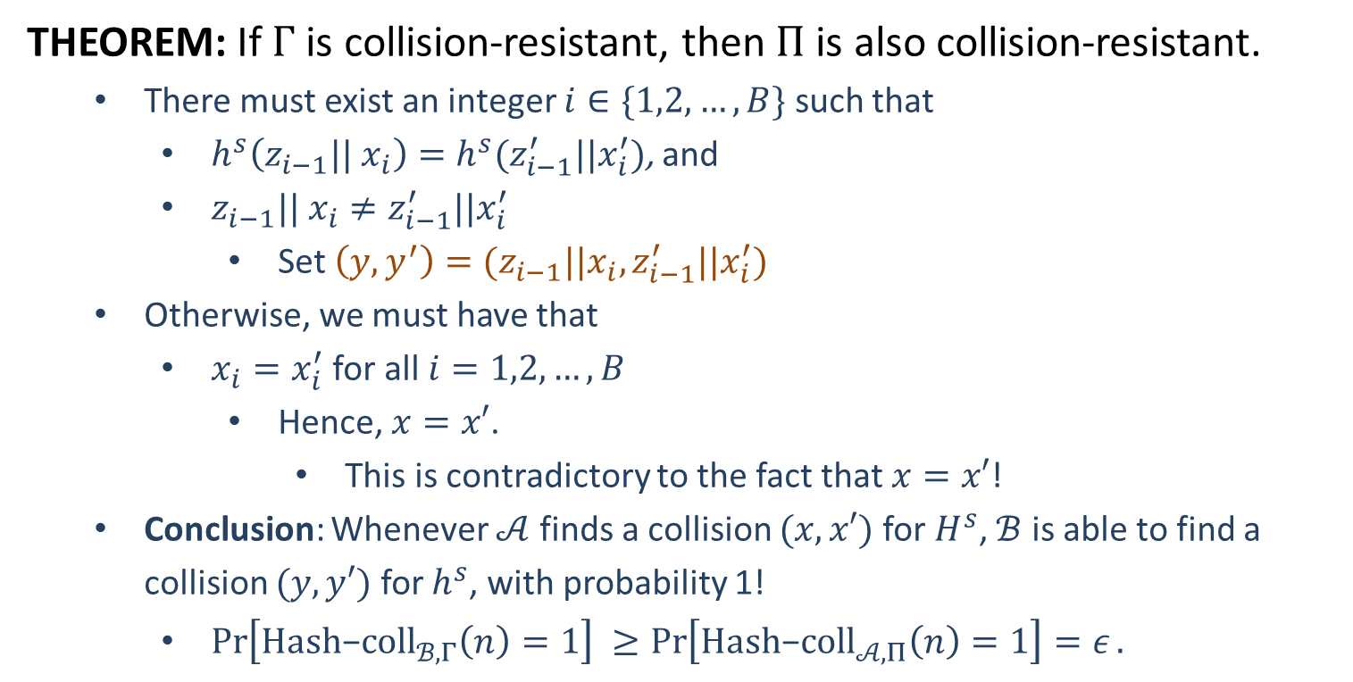
Merkle-Damgård Transform
THEOREM: If $Γ$ is collision-resistant, then $Π$ is also collision-resistant.
There must exist an integer $i∈\{1,2,…,B\}$ such that
$h^{s}\left(z_{i−1}|| x_{i}\right)=h^{s}(z_{i−1}^{′}||x_{i}^{′})$, and
$z_{i−1}|| x_{i}≠z_{i−1}^{′}||x_{i}^{′}$
Set $\left(y,y^{′}\right)=(z_{i−1}||x_{i},z_{i−1}^{′}||x_{i}^{′})$
Otherwise, we must have that
$x_{i}=x_{i}^{′}$ for all $i=1,2,…,B$
Hence, $x=x′$.
This is contradictory to the fact that $x=x′$!
Conclusion: Whenever $𝒜$ finds a collision $(x,x′)$ for $H^{s}$, $ℬ$ is able to find a collision $(y,y′)$ for $h^{s}$, with probability 1!
$\operatorname{Pr}\left[Hash\text{−}coll_{ℬ,Γ}\left(n\right)=1\right] ≥\operatorname{Pr}\left[Hash\text{−}coll_{𝒜,Π}\left(n\right)=1\right]=ε.$

Slide 8
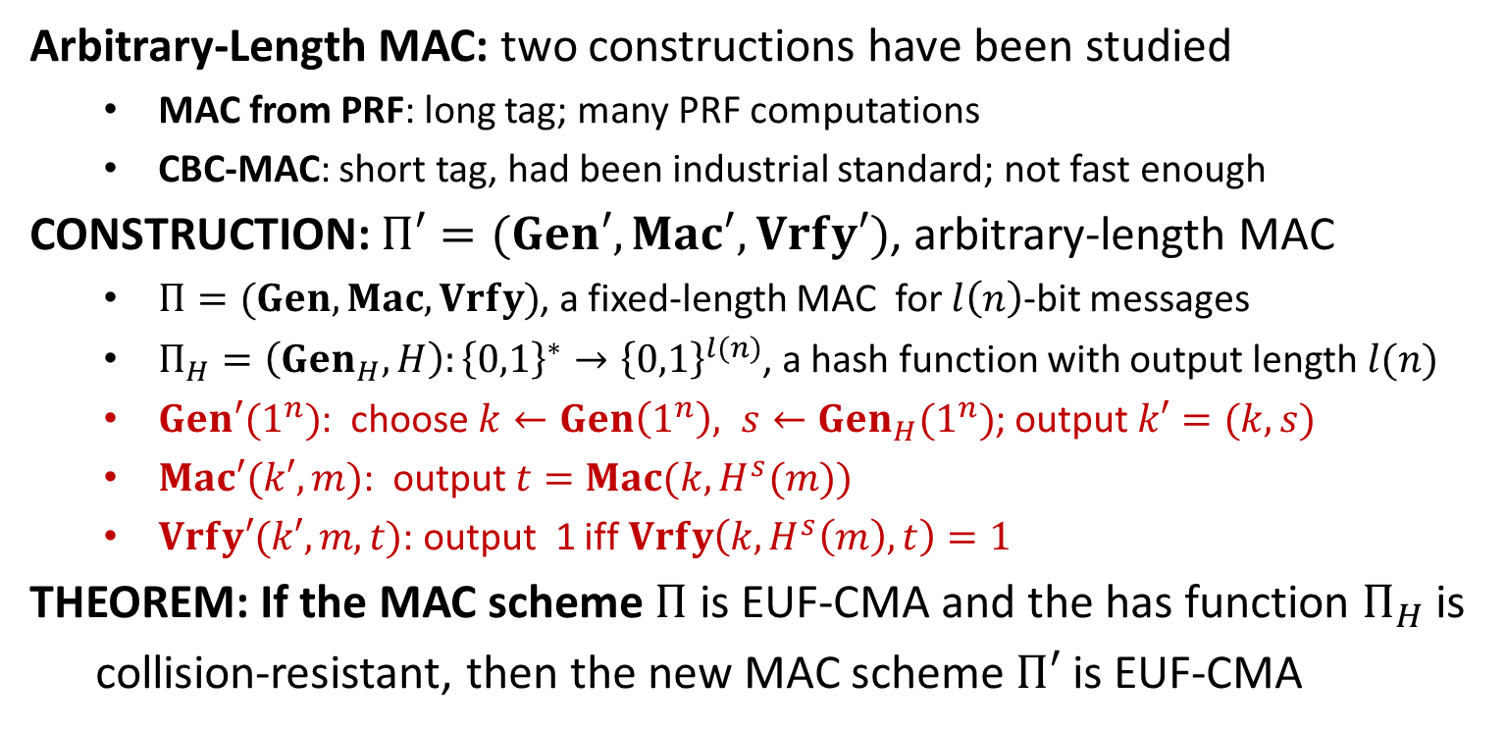
Hash-and-MAC
Arbitrary-Length MAC: two constructions have been studied
MAC from PRF: long tag; many PRF computations
CBC-MAC: short tag, had been industrial standard; not fast enough
CONSTRUCTION: $Π′=(Gen′,Mac′, Vrfy′)$, arbitrary-length MAC
$Π=(Gen, Mac, Vrfy)$, a fixed-length MAC for $l\left(n\right)$-bit messages
$Π_{H}=\left(Gen_{H}, H\right):{\left\{0,1\right\}}^{∗}→{\left\{0,1\right\}}^{l(n)}$, a hash function with output length $l(n)$
$Gen′(1^{n})$: choose $k←Gen\left(1^{n}\right), s←Gen_{H}(1^{n})$; output $k′=(k,s)$
$Mac′(k′,m)$: output $t=Mac(k, H^{s}(m))$
$Vrfy′(k′,m,t)$: output 1 iff $Vrfy\left(k,H^{s}\left(m\right),t\right)=1$
THEOREM: If the MAC scheme $Π$ is EUF-CMA and the has function $Π_{H}$ is
collision-resistant, then the new MAC scheme $Π′$ is EUF-CMA

Slide 9

















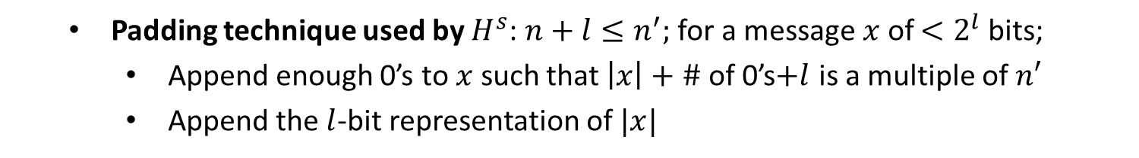






HMAC
CONSTRUCTION: $Π=(Gen, Mac, Vrfy)$, hashed MAC-industry standard
Tools: $\left(Gen′, H\right),$ MD transform of $(Gen, h)$ (compresses $n+n′$-bit to $n$-bit)
$$k⊕ipad$$
$$x_{1}$$
$$⋯$$
$$x_{d}$$
$${y=H}^{s}((k⊕ipad)||m)$$
$$IV$$
$$h^{s}$$
$$h^{s}$$
$$⋯$$
$$h^{s}$$
$$k_{in}$$
$$y^{′}=y||0⋯0||⋯$$
$$k⊕opad$$
$$h^{s}$$
$$h^{s}$$
$$t$$
$$IV$$
$$k_{out}$$
$$h^{s}(IV||k⊕opad)$$
Padding technique used by $H^{s}$: $n+l≤n^{′};$ for a message $x$ of $<2^{l}$ bits;
Append enough 0’s to $x$ such that $\left|x\right|+\#$ of 0’s$+l$ is a multiple of $n′$
Append the $l$-bit representation of $|x|$
$$x$$
$$0⋯0$$
$$|x|$$

Slide 11
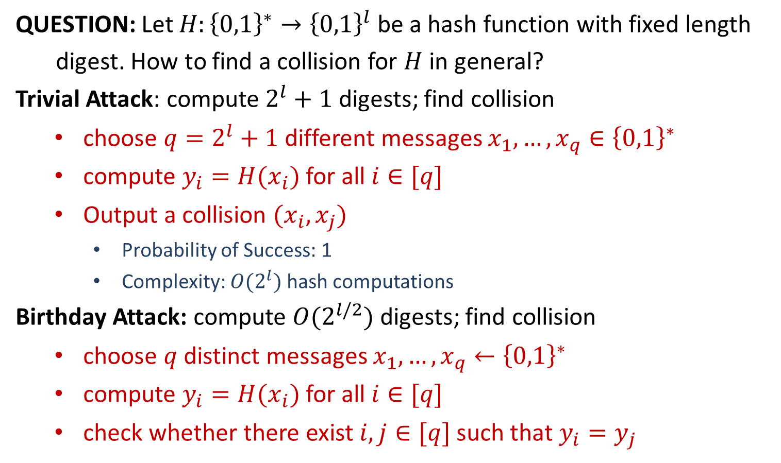
Attacks of Hash Functions
QUESTION: Let $H:{\left\{0,1\right\}}^{∗}→{\left\{0,1\right\}}^{l}$ be a hash function with fixed length
digest. How to find a collision for $H$ in general?
Trivial Attack: compute $2^{l}+1$ digests; find collision
choose $q=2^{l}+1$ different messages $x_{1},…,x_{q}∈{\left\{0,1\right\}}^{∗}$
compute $y_{i}=H(x_{i})$ for all $i∈[q]$
Output a collision $(x_{i},x_{j})$
Probability of Success: 1
Complexity: $O(2^{l})$ hash computations
Birthday Attack: compute $O(2^{l/2})$ digests; find collision
choose $q$ distinct messages $x_{1},…,x_{q}←{\left\{0,1\right\}}^{∗}$
compute $y_{i}=H(x_{i})$ for all $i∈[q]$
check whether there exist $i,j∈[q]$ such that $y_{i}=y_{j}$

Slide 12
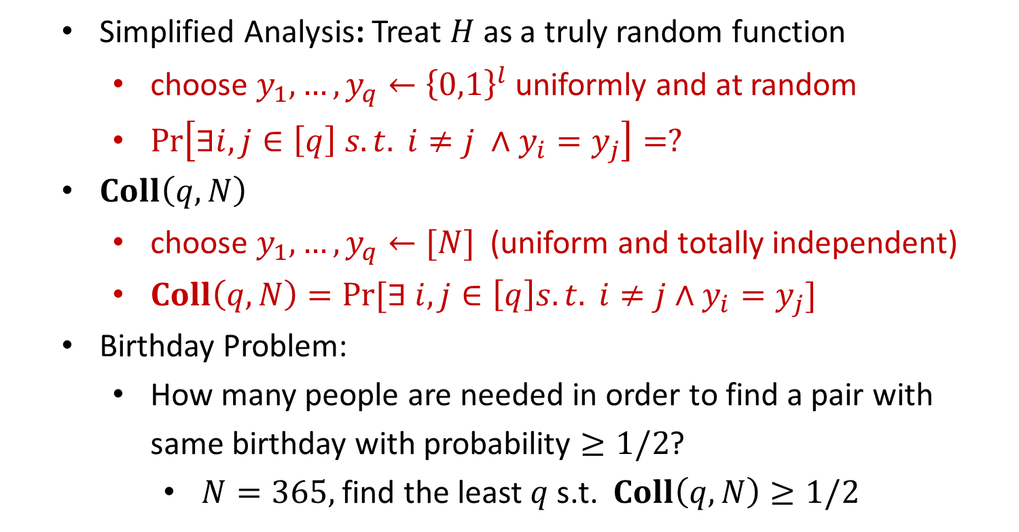
Attacks of Hash Functions
Simplified Analysis: Treat $H$ as a truly random function
choose $y_{1},…,y_{q}←{\left\{0,1\right\}}^{l}$ uniformly and at random
$\operatorname{Pr}\left[∃i,j∈\left[q\right] s.t. i≠j ∧y_{i}=y_{j}\right]=?$
$Coll\left(q,N\right)$
choose $y_{1},…,y_{q}←[N]$ (uniform and totally independent)
$Coll\left(q,N\right)=Pr⁡[∃ i,j∈\left[q\right]s.t. i≠j∧y_{i}=y_{j}]$
Birthday Problem:
How many people are needed in order to find a pair with same birthday with probability $≥1/2$?
$N=365,$find the least $q$ s.t. $Coll\left(q,N\right)≥1/2$

